Slide 1
Introduction to Statistical Methods
ISM Team

Slide 2
Section
Faculty Name & Mail ID:
LF Details
Session 2
(3rd August 2025)
Axioms of Probability, Probability basics, Mutually exclusive and Independent events

Slide 3
Module 1: (Basic Probability & Statistics)
Module 1: (Basic Probability & Statistics)
Contact Session | List of Topic Title | Reference
CS - 2 | Axioms of Probability, Mutually exclusive and independent events, Problem solving to understand basic probability concepts | T1 & T2

Slide 4
Random Experiment
Flip a coin. Did it land with heads or tails facing up?
Walk to a bus stop. How long do you wait for the arrival of a bus?
Give a lecture. How many students are listening?
Transmit one of a collection of waveforms over a channel. What waveform arrives at the receiver?
Transmit one of a collection of waveforms over a channel. Which waveform does the receiver identify as the transmitted waveform?

Slide 5
Random Experiment
The term "random experiment" is used to describe any action whose outcome is not known in advance.
Examples:
Counting how many times a certain word or a combination of words appears in the text of the “King Lear” or in a text of Confucius.
Pulling a card from the deck.
Monitor three consecutive phone calls going through a telephone switching office. Classify each one as a voice call (v) if someone is speaking, or a data call (d) if the call is carrying a modem or fax signal.

Slide 6
Sample Space
The sample space of a random experiment is a set S that includes all possible outcomes of the experiment.
Example:
If the experiment is to throw a die and record the outcome, then, sample space is S = { 1,2,3,4,5,6}
Manufacture an integrated circuit and test it to determine whether it meets quality objectives.
The possible outcomes are “accepted” (a) and “rejected” (r).
The sample space is S ={a,r}.

Slide 7
Event
An event is a subset of the sample space of a random experiment.
An event is a set of outcomes of the experiment. This includes the null (empty) set of outcomes and the set of all outcomes.
Each time the experiment is run, a given event A either occurs, if the outcome of the experiment is an element of A, or does not occur, if the outcome of the experiment is not an element of A.

Slide 8
Complement of an Event
The complement of event A is defined to be the event consisting of all sample points that are not in A.
The complement of A is denoted by A^{c}.
The Venn diagram below illustrates the concept of a complement.

Slide 9
Union & Intersection
UNION
The union of events A and B is the event containing all sample points that are in A or B or both.
The union is denoted by A U B
The union of A and B is illustrated below.
INTERSECTION
The intersection of events A and B is the set of all sample points that are in both A and B.
The intersection of A and B is the area of overlap in the illustration below.

Slide 10
Mutually Exclusive Events
Two events are said to be mutually exclusive if the events have no sample points in common. That is, two events are mutually exclusive if, when one event occurs, the other cannot occur.
Example : A simple example is flipping a coin and getting either heads or tails – you can't get both simultaneously.
Example: A student wants to go to school. There are two paths; one that takes him to school and the other one that takes him home. Which path will he choose? He will choose one of the two paths. Obviously, he can't choose both at the same time. This is an example of a mutually exclusive events.

Slide 11
Definition of Probability
Classical approach:

Slide 12
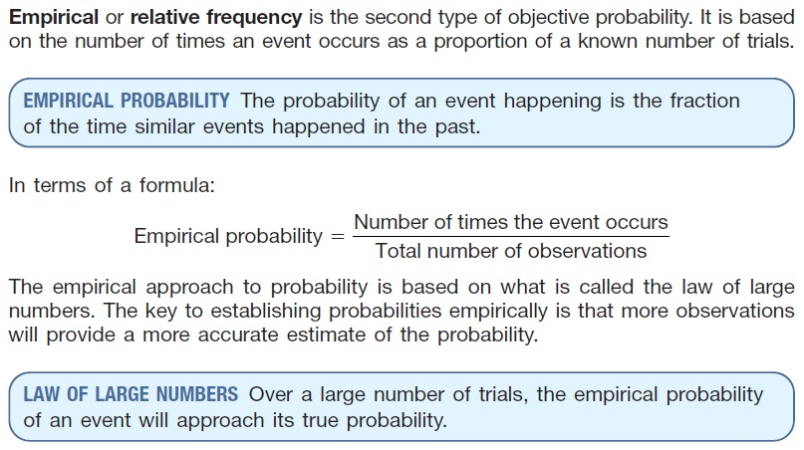
Empirical approach

Slide 13
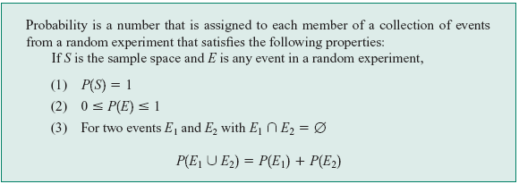
Axiomatic approach
Definition :

Slide 14
Probability as a Numerical Measure of the Likelihood of Occurrence
Increasing Likelihood of Occurrence
0
.5
1
Probability:
The occurrence of the event is just as likely as it is unlikely.

Slide 15
The Addition Rule
The probability that event A or B will occur is given by
P (A U B) = P (A) + P (B) – P (A ∩ B ).
If events A and B are mutually exclusive, then the rule can be simplified to
P (A U B) = P (A) + P (B).

Slide 16
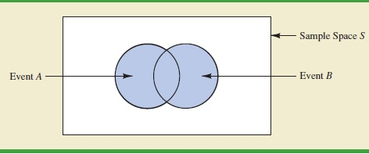
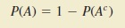
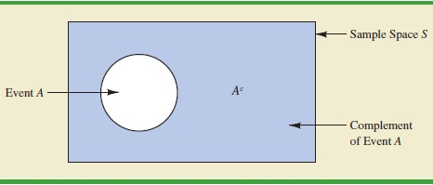
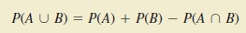
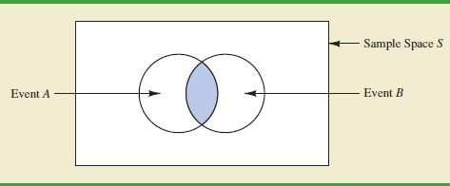
Probability and Venn Diagram

Slide 17
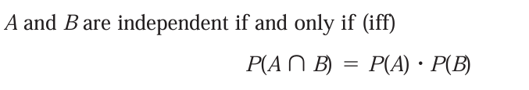
Independent & Dependent
Events are either
Independent (the occurrence of one event has no effect on the probability of occurrence of the other) or
Dependent (the occurrence of one event gives information about the occurrence of the other)
Example : Flipping a coin multiple times, where each flip is independent of the others.
Independent events do not need to be mutually exclusive. Two events can be independent and still occur simultaneously.

Slide 18
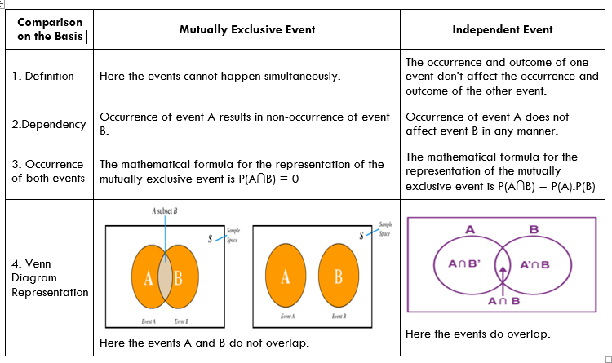
Comparison between Mutually Exclusive events and Independent Events

Slide 19
Example 1
An experiment has the four possible mutually exclusive outcomes A, B, C, D. Check whether the following assignments of probability are permissible:
P(A)= 0.38, P(B) = 0.16, P(C) =0.11, P(D) = 0.35
P(A)= 0.31, P(B) = 0.27, P(C) =0.28, P(D) = 0.16
P(A)= 0.32, P(B) = 0.27, P(C) = -0.06, P(D) = 0.47
P(A)= 1/2, P(B) = 1/4, P(C) = 1/8, P(D) = 1/16
P(A)= 5/8, P(B) = 1/6, P(C) = 1/3, P(D) = 2/9

Slide 20
Example 1
An experiment has the four possible mutually exclusive outcomes A, B, C, D. Check whether the following assignments of probability are permissible:
P(A)= 0.38, P(B) = 0.16, P(C) =0.11, P(D) = 0.35 Permissible
P(A)= 0.31, P(B) = 0.27, P(C) =0.28, P(D) = 0.16 NOT
P(A)= 0.32, P(B) = 0.27, P(C) = -0.06, P(D) = 0.47 NOT
P(A)= 1/2, P(B) = 1/4, P(C) = 1/8, P(D) = 1/16 NOT
P(A)= 5/8, P(B) = 1/6, P(C) = 1/3, P(D) = 2/9 NOT

Slide 21
Example 2
If two dice are thrown , what is the probability that the sum is
Greater than 8
Less than 6
Neither 7 nor 11

Slide 22
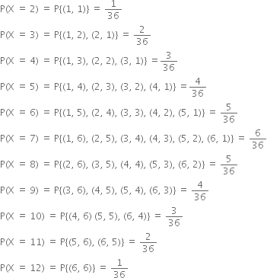
Solution
Probability of outcome, when a pair of die is thrown:

Slide 23
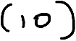






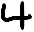

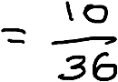

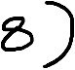
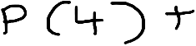




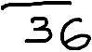


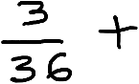
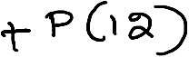







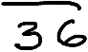



Continued..
If two dice are thrown , what is the probability that the sum is
Greater than 8
b)Less than 6:

Slide 24

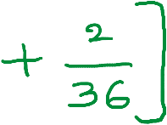









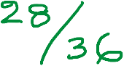





Continued
c) Neither 7 nor 11

Slide 25
Example 3
The probability that a student passes in statistics examination is 2/3 and the probability that he /she will not pass in mathematics examination is 5/9. The probability that he/she will pass in at least one of the examination is 4/5.
Find the probability that he /she will pass in both the examinations

Slide 26
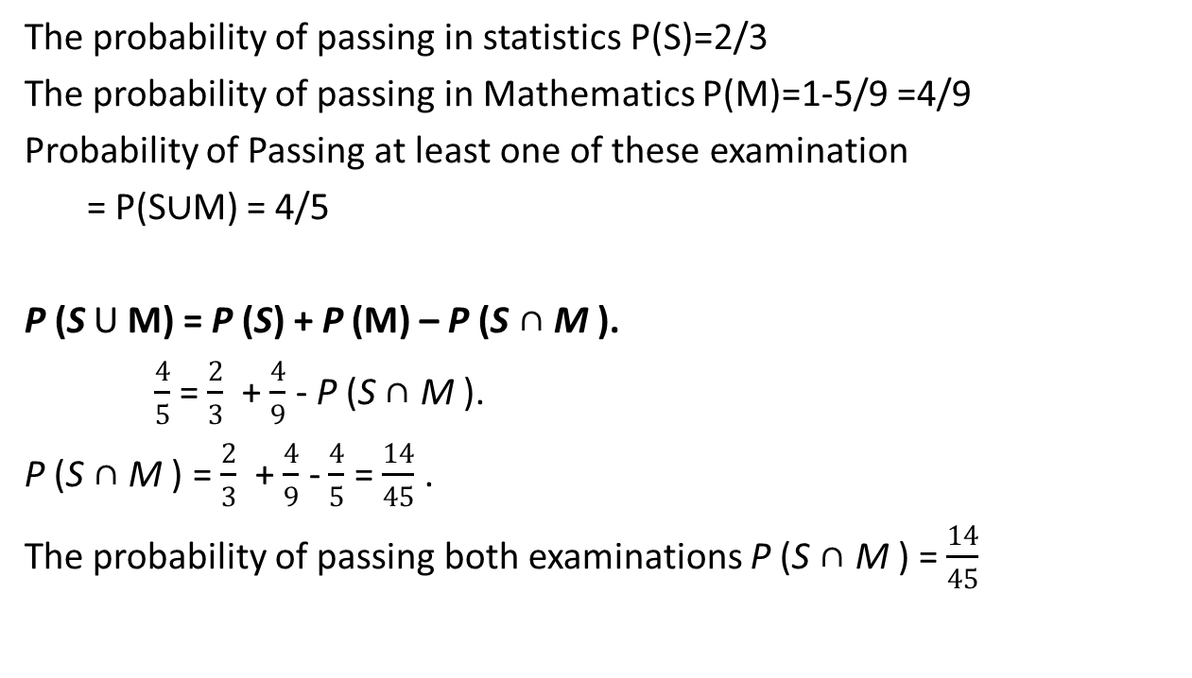
Solution
The probability of passing in statistics P(S)=2/3
The probability of passing in Mathematics P(M)=1-5/9 =4/9
Probability of Passing at least one of these examination
= P(S$∪$M) = 4/5
P (S U M) = P (S) + P (M) – P (S ∩ M ).
$\frac{4}{5}$ = $\frac{2}{3}$ + $\frac{4}{9}$ - P (S ∩ M ).
P (S ∩ M ) = $\frac{2}{3}$ + $\frac{4}{9}$ - $\frac{4}{5}$ = $\frac{14}{45}$ .
The probability of passing both examinations P (S ∩ M ) = $\frac{14}{45}$

Slide 27
Example 4
Suppose that 75% of all investors invest in traditional annuities and 45% of them invest in the stock market. If 85% invest in the stock market and/or traditional annuities, what percentage invest in both?

Slide 28
Solution
Let A be the event that a randomly selected investor invests in traditional annuities.
Let B be the event that he or she invests in the stock market.
Then P (A) = 0.75, P (B) = 0.45, and P (A ∪ B) = 0.85
Since,
P (AB) = P (A) + P (B) − P (A ∪ B)
= 0.75 + 0.45 − 0.85
= 0.35.

Slide 29
Example 5
Suppose the manufacturer’s specifications for the length of a certain type of computer cable are 2000 ± 10 millimeters. In this industry, it is known that small cable is just as likely to be defective (not meeting specifications) as large cable. That is, the probability of randomly producing a cable with length exceeding 2010 millimeters is equal to the probability of producing a cable with length smaller than 1990 millimeters. The probability that the production procedure meets specifications is known to be 0.99.
What is the probability that a cable selected randomly is too large?
(b) What is the probability that a randomly selected cable is larger than 1990 millimeters?

Slide 30
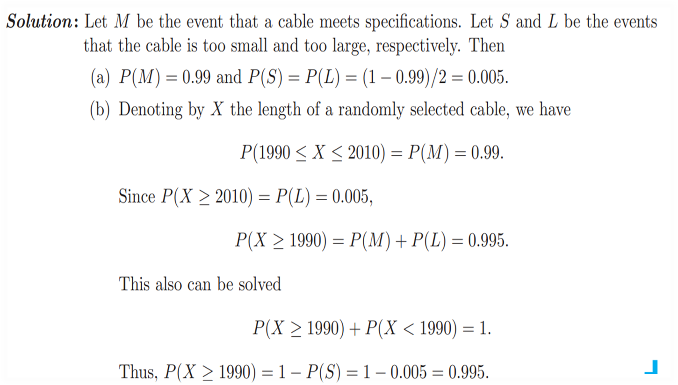
Solution

Slide 31
Example 6
Let S be a sample space and A and B are two mutually exclusive events such that AUB = S. If P(.) denotes the probability of the event, then what is the maximum value of P(A).P(B)?
Solution:
P(A) + P(B) = 1,since A and B are mutually exclusive
When sum is a constant , product of two numbers becomes maximum when they are equal
So, P(A) = P(B) = ½
Hence P(A).P(B) = 1/4

Slide 32
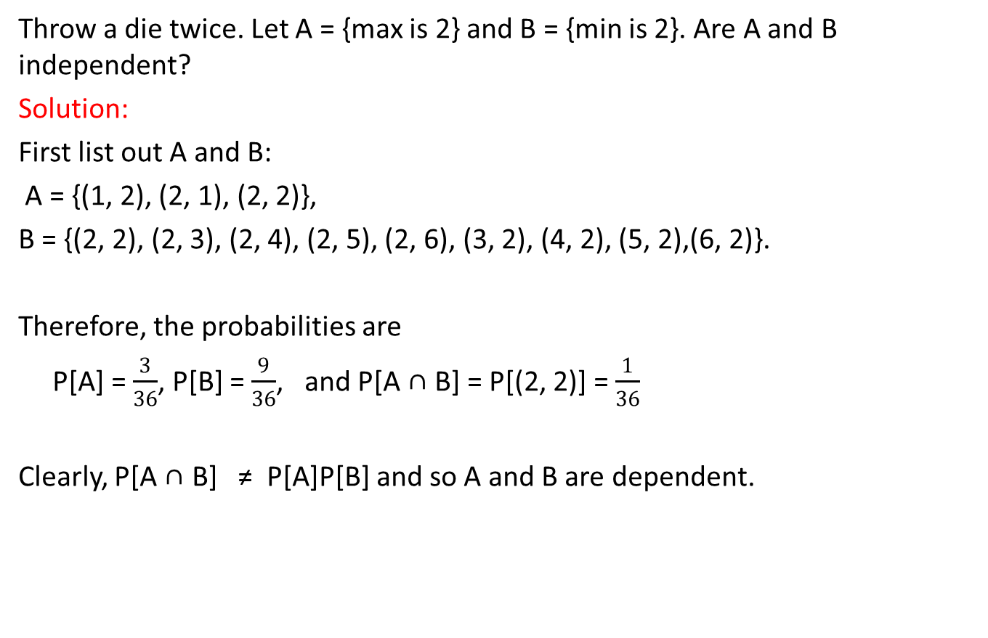
Example 7
Throw a die twice. Let A = {max is 2} and B = {min is 2}. Are A and B independent?
Solution:
First list out A and B:
A = {(1, 2), (2, 1), (2, 2)},
B = {(2, 2), (2, 3), (2, 4), (2, 5), (2, 6), (3, 2), (4, 2), (5, 2),(6, 2)}.
Therefore, the probabilities are
P[A] = $\frac{3}{36}$, P[B] = $\frac{9}{36}$, and P[A ∩ B] = P[(2, 2)] = $\frac{1}{36}$
Clearly, P[A ∩ B] ≠ P[A]P[B] and so A and B are dependent.

Slide 33
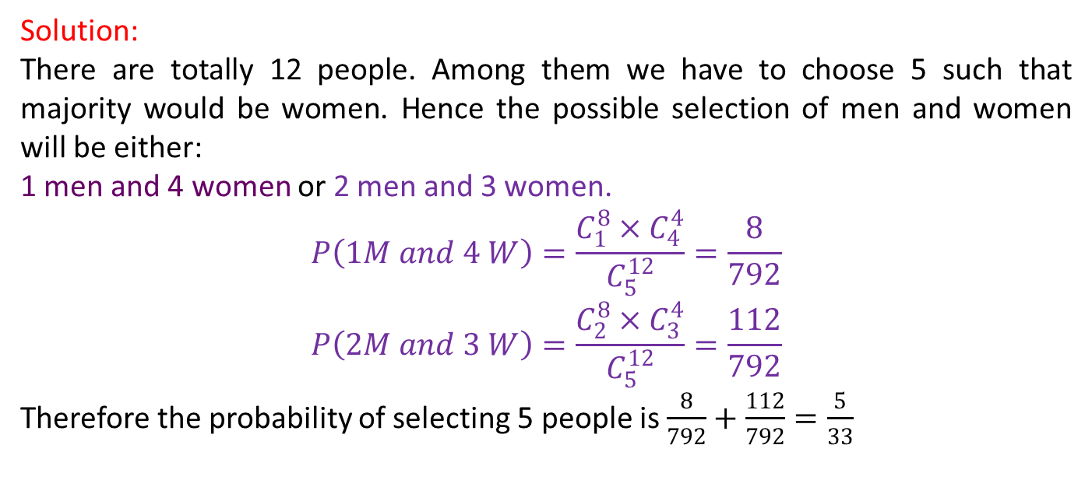
Example 8
A committee of 5 is chosen from a group of 8 men and 4 women. What is the probability that the group contains a majority of women?
Solution:
There are totally 12 people. Among them we have to choose 5 such that majority would be women. Hence the possible selection of men and women will be either:
1 men and 4 women or 2 men and 3 women.
$$P\left(1M and 4 W\right)=\frac{C_{1}^{8}×C_{4}^{4}}{C_{5}^{12}}=\frac{8}{792}$$
$$P\left(2M and 3 W\right)=\frac{C_{2}^{8}×C_{3}^{4}}{C_{5}^{12}}=\frac{112}{792}$$
Therefore the probability of selecting 5 people is $\frac{8}{792}+\frac{112}{792}=\frac{5}{33}$

Slide 34
Practice problems
Q1: A Survey conducted by a bank revealed that 40% of the accounts are savings accounts and 35% of the accounts are current accounts and the balance are loan accounts.
What is the probability that an account taken at random is a loan account ? Ans: 0.25
What is the probability that an account taken at random is NOT savings account ? Ans: 0.60
What is the probability that an account taken at random is NOT a current account ? Ans: 0.65
What is the probability that an account taken at random is a current account or a loan account? Ans: 0.60

Slide 35
Practice Problems
Q2. A speaks truth in 80% cases and B speaks in 60% cases. What percentage of cases are they likely to contradict each other in stating the same fact.
Hint / Ans: P(Contradiction)=P(A truth and B false)+P(A false and B truth)=0.32+0.12=0.44
Q3. In a certain residential suburb, 60% of all households get Internet service from the local cable company, 80% get television service from that company, and 50% get both services from that company. If a household is randomly selected,
What is the probability that it gets at least one of these two services from the company?
Ans: P(Internet or Television)=0.90
What is the probability that it gets exactly one of these services from the company?
Ans: P(Exactly one service)=P(Internet but not Television)+P(Television but not Internet)=0.10+0.30=0.40

Slide 36
Practice problems
Q4: The next generation of miniaturised wireless capsules with active locomotion will require two miniature electric motors to manoeuvre each capsule. Suppose 10 motors have been fabricated but that, in spite of test performed on the individual motors 2 will not operate satisfactorily when placed into capsule, to fabricate a new capsule,2 motors will be randomly selected(that is, each pair of motors has the same chance of being selected ) find the probability that
Both motors will operate satisfactorily in the capsule.
One motor will operate satisfactorily and other will not.

Slide 37
Practice problems
Q5. Suppose that 55% of all adults regularly consume coffee, 45% regularly consume carbonated soda, and 70% regularly consume at least one of these two products.
i) What is the probability that a randomly selected adult regularly consumes both coffee and soda?
ii) What is the probability that a randomly selected adult doesn’t regularly consume at least one of these two products?

Slide 38
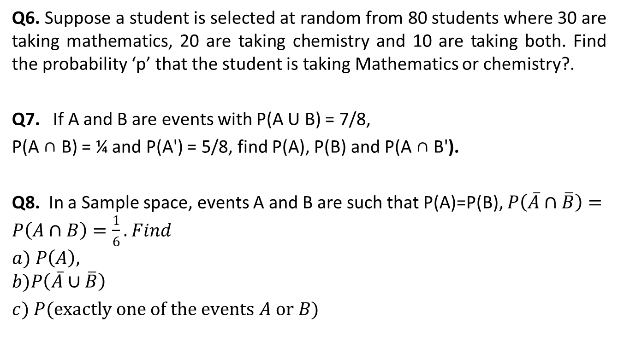
Practice problems
Q6. Suppose a student is selected at random from 80 students where 30 are taking mathematics, 20 are taking chemistry and 10 are taking both. Find the probability ‘p’ that the student is taking Mathematics or chemistry?.
Q7. If A and B are events with P(A U B) = 7/8,
P(A ∩ B) = ¼ and P(A') = 5/8, find P(A), P(B) and P(A ∩ B').
Q8. In a Sample space, events A and B are such that P(A)=P(B), $P\left(\overline{A}∩\overline{B}\right)=P\left(A∩B\right)=\frac{1}{6}.$ $Find$
$$a) P\left(A\right),$$
$$b)P\left(\overline{A}∪\overline{B}\right)$$
$c) P(exactly one of the events A or B)$

Slide 39
Practice problems
Q9. An insurance company offers four different deductible levels—none, low, medium, and high—for its homeowner’s policyholders and three different levels—low, medium, and high—for its automobile policyholders. The accompanying table gives proportions for the various categories of policyholders who have both types of insurance.
For example, the proportion of individuals with both low homeowner’s deductible and low auto deductible is .06 (6% of all such individuals).
Auto | N | L | M | H
L | 0.04 | 0.06 | 0.05 | 0.03
M | 0.07 | 0.10 | 0.20 | 0.10
H | 0.02 | 0.03 | 0.15 | 0.1
Suppose an individual having both types of policies is randomly selected.
a. What is the probability that the individual has a medium auto deductible and a high homeowner’s deductible?
b. What is the probability that the individual has a low auto deductible? A low homeowner’s deductible?
c. What is the probability that the individual is in the same category for both auto and homeowner’s deductibles?
d. Based on your answer in part (c), what is the probability that the two categories are different?
e. What is the probability that the individual has at least one low-deductible level ?
f. Using the answer in part (e), what is the probability that neither deductible level is low ?

Slide 40
Glossary
Random experiment- an experiment whose outcome is uncertain before performing it.
Sample space-set of all possible outcomes of an experiment.
Event- outcome of an experiment.
Equally Likely Outcomes – Outcomes which are having same probability
Mutually exclusive events-events that do not occur at the same time.
Independent events- the events which occur freely of each other.
Operations on events
Union of events and its probability
Intersection of events and its probability
Complement of an event and its probability

Slide 41
Thank You!

